Slide 1
Hospital Management System
Presented by:-
Saranya v 231801155
Sangamithra v 231801147
Ramya a 231801135

Slide 2
Problem Statement
The manual processes in hospitals lead to inefficiencies and errors in managing patient information.
Inefficient record-keeping, human errors in data entry, and poor coordination between departments result in delayed treatments and a frustrating patient experience.
There is a critical need for an integrated Hospital Management System to streamline operations and improve patient care

Slide 3
OBJECtive
To develop a comprehensive Hospital Management System that streamlines operations, enhances patient care, and improves data management.
By centralizing patient records and providing real-time access to information, the system will improve communication among healthcare providers and ensure high-quality care while maintaining regulatory compliance and data security.

Slide 4
introduction
Overview: Hospital Management Systems (HMS) are essential software solutions for efficiently managing hospital operations, including patient records, appointments, billing, and medical records.
Importance in Healthcare: HMS streamline administrative tasks, reduce errors, and improve data security, enabling healthcare providers to focus more on patient care.
Role of Technology: Technology enhances healthcare processes by automating tasks, ensuring data security, and facilitating communication within the hospital.
Impact on Patient Care: Centralized data improves the quality of care through quick access to medical histories, accurate billing, and efficient scheduling, ultimately enhancing patient experiences.

Slide 5
abstract
The Hospital Management System (HMS) streamlines hospital operations, enhances patient care, and improves data management by centralizing patient records, appointment scheduling, billing, and staff coordination.
By automating administrative processes, the HMS reduces wait times and enhances communication among healthcare providers, leading to better patient outcomes by using simple system while ensuring compliance with healthcare regulations and safeguarding sensitive data.

Slide 6
Existing system
Existing hospital management systems face challenges that hinder efficiency and patient care. online access of patients .
Many hospitals rely on separate software, leading to delays and errors in accessing patient information.
Appointment scheduling can cause double bookings and increased wait times.
Billing processes are often complicated and prone to errors, resulting in payment delays.
Digital storage of patients record, Poor integration makes data sharing difficult, while inadequate security increases the risk of unauthorized access. Overall, these limitations negatively impact healthcare delivery.

Slide 7
Disadvantages of Existing System
High likelihood of human error.
Time-consuming processes.
Difficulty in accessing historical data.
Poor data security.

Slide 8
Proposed system
The proposed Hospital Management System (HMS) will address current challenges by providing a centralized database for patient records, automated appointment scheduling, and streamlined billing processes.
It will offer real-time access to information, improve data security, and include reporting tools for better decision-making.
This system aims to enhance operational efficiency and improve patient care.

Slide 9
Advantages of proposed system
Increased efficiency and accuracy.
Better patient data accessibility.
Improved security and data protection.
Ease of managing and retrieving records.

Slide 10
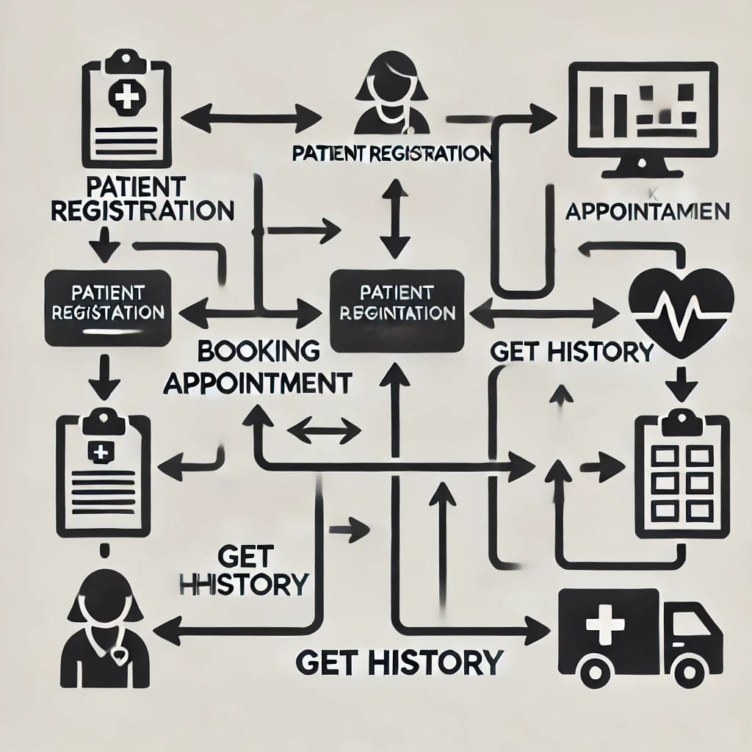
Architecture Diagram

Slide 11
Modules with Description
Doctor Management: Maintains doctor profiles and schedules.
Appointment Scheduling: Allows patients to book, view, and manage appointments.
Billing Management: Handles billing and payment records.
Medical Records Management: Keeps detailed medical histories.
User Authentication: Manages user roles and permissions for secure access.

Slide 12

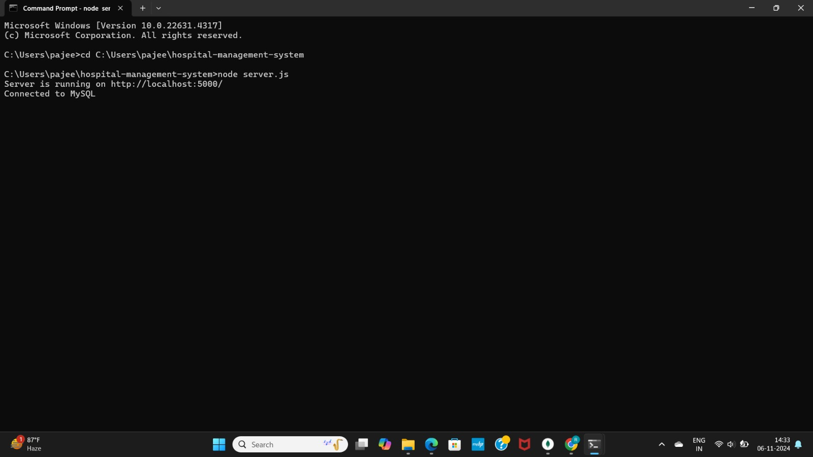
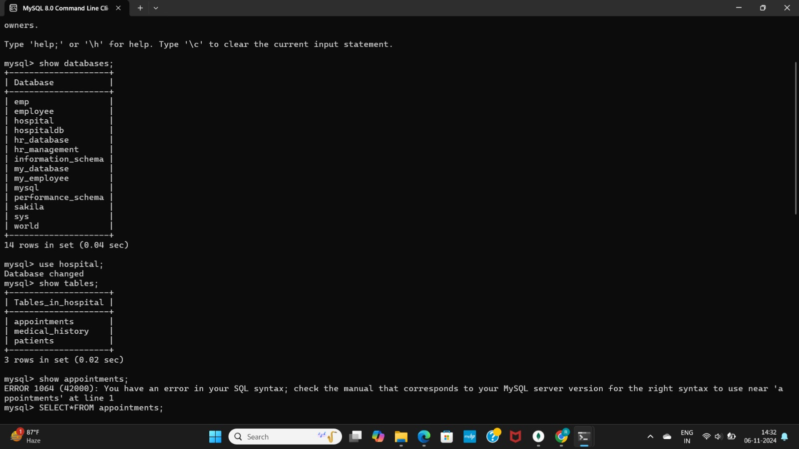
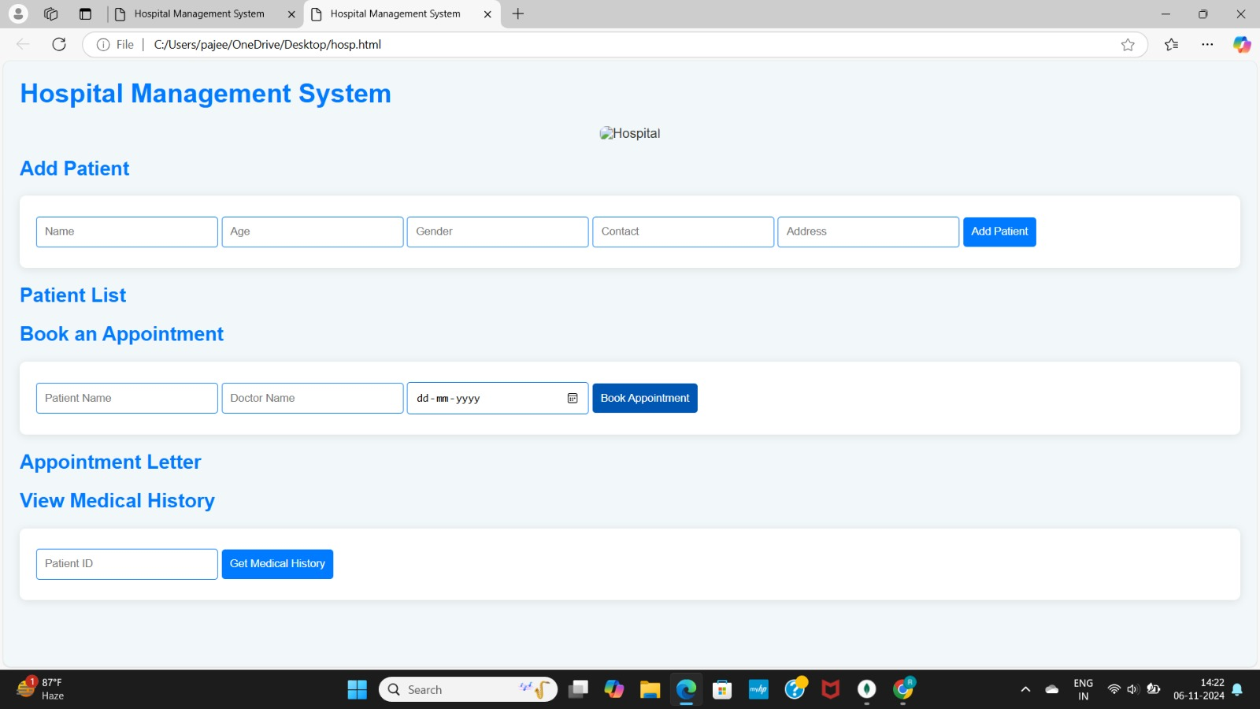
Sample output

Slide 13
Conclusion and Future Work
Conclusion:
The Hospital Management System (HMS) improves hospital operations by automating tasks like patient management, appointment scheduling, billing, and record-keeping.
Key benefits include enhanced data accuracy, better patient care, and secure data management.
Future Work:
Mobile Application: Add a mobile version for easier access.
Telehealth Integration: Include features for remote consultations.
Data Analytics: Implement tools to analyze patient trends and resource use.

Slide 14
References
W3Schools. (n.d.). HTML Tutorial. Retrieved
fromhttps://www.w3schools.com/html/
W3Schools. (n.d.). CSS Tutorial. Retrieved
from https://www.w3schools.com/css/
W3Schools. (n.d.). SQL Tutorial. Retrieved from https://www.w3schools.com/sql/

